Slide 1

Project Presentation

Slide 2
Table of contents
01
02
About us
Our goal
03
04
Progression
Technologies
Get to know our team
Hear about our goal
You can describe the topic of the section here
You can describe the topic of the section here

Slide 3
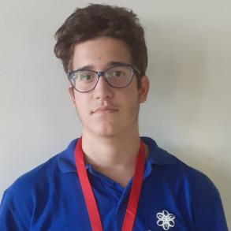
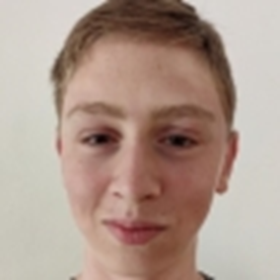
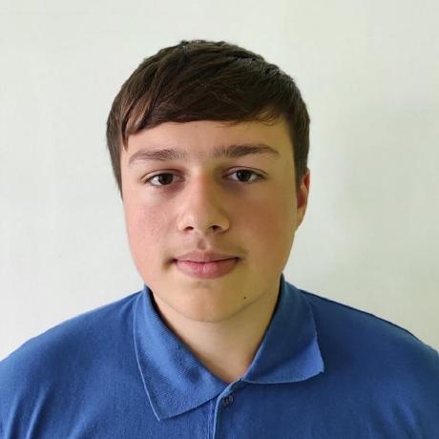
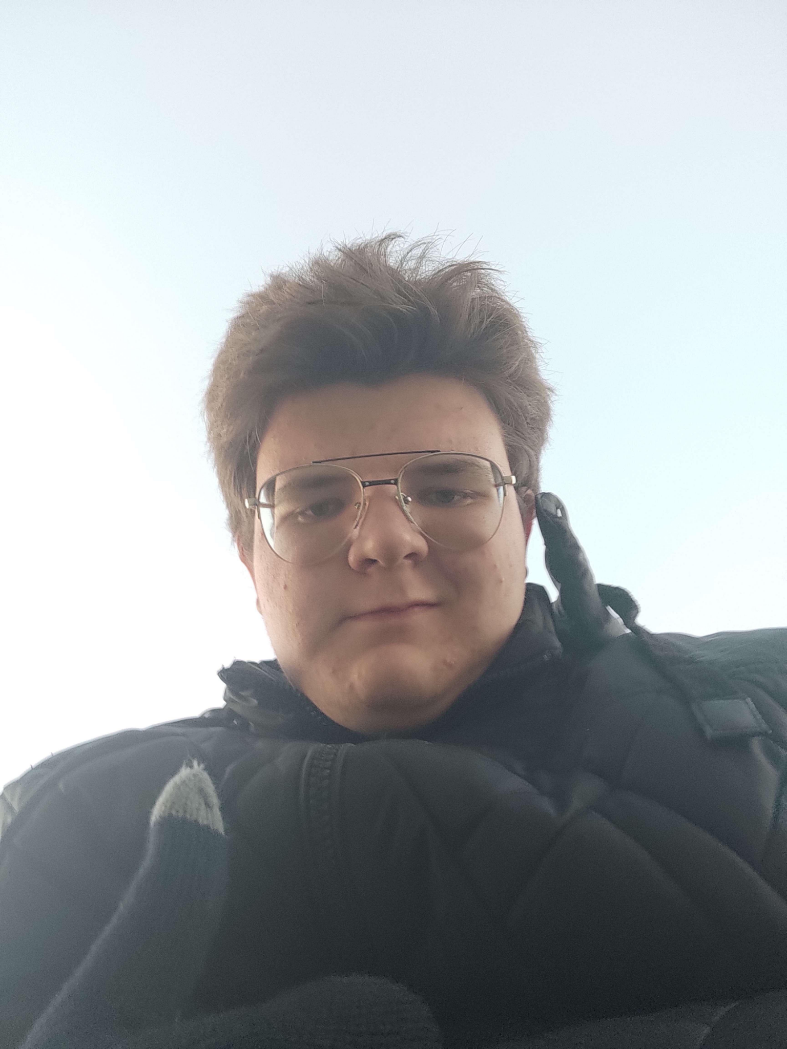
01
Our Team
Dimitar Dimitrov Team Lead
Daniil Chebotarev Backend Developer
Daniil Furnika Backend Developer
Yordan Stoyanov Lead Design

Slide 4
02
Our Goal
-Create a fun game, inspired by “Cookie Clicker”, where one has to click on the flower to get nutrients for his plant and then make it grow stronger. This way, we educate the user on useful nutrients for the soil.

Slide 5
Progression
The Start
Three weeks in
Two weeks in
Four weeks in
We started off as a small team of enthusiastic young people, and then we started thinking on what we should do on this topic.
We have decided the main game design and mechanics. Only the creation is left.
We finally made up what we wanted to do and gathered information on the project.
Due to high load with school, we were unable to properly maintain a steady workflow, but we managed to finish the project in time.

Slide 6








04
Technologies

Slide 7
Next Stage:
Application Showcase
Template provided by: slidesgo.com

